Slide 1

Presentation on Advanced Gas Leak Prevention with Smart Sensor Network
By
Presenter name: Mayuri Tambe.
Affiliation: Jain College of Engineering and Research, Belagavi.

Slide 2
Agenda
Introduction
Literature Survey
Objectives of Proposed system
Material Specifications
Experimental Work
Results and Discussion
Conclusion
References

Slide 3
Introduction
LPG cylinders were widely used in cities and metropolitan regions in the early days, demand has also been increasing in rural areas in recent years.
Liquefied petroleum gas is an extremely flammable gas.With the increase in LPG demand and consumption, it has become mandatory to monitor the risk of LPG cylinders.
One significant drawback of natural gas is that it is heavier than air, hence it fails to diffuse easily and might potentially lead to suffocation when inspired.
The deadliest industrial chemical disaster in history, the Bhopal Gas Tragedy, happened in India in 1984. Due to the unintended release of the lethal gas methyl isocyanate (MIC), the Bhopal Gas catastrophe—the most horrific chemical disaster in history—saw the deaths of over 2500 people.
About 130 catastrophic chemical accidents with 259 fatalities and 563 major injuries in India during the previous 10 years have been recorded.
System that possesses capacity to detect LPG gas leakage and turns OFF the system automatically is needed.

Slide 4
Literature Survey
S. Lakshmi Lavanya et al, have implemented a system which senses the gas leakage. It senses normal gases like O2, H2, etc it will emit a green light and if it senses the LPG in the air, it will emit a red light, and the SMS is dispatched to the owner and makes a call.
Juhi Choudhary et al, have implemented gas leakage surveillance and an automatic alert system. Here, the gas leakage is identified by the gas sensor and an SMS is forwarded to the owner through the GSM module.
Prof Babasaheb Jadhav et al, have implemented a proposed system, the gas leakage is determined by the MQ2 gas sensor, and the signal is passed to Arduino UNO. Further, Arduino UNO sends a command to the GSM module and the GSM module warns the owner.
In our research to highlight the novelty of the proposed system, an additional study is conducted, in scenarios where flame extinguishment occurs due to external unavoidable factors, the knob of the burners automatically turns OFF. The response time for knob deactivation is measured at 0.63 milliseconds. Additionally, to address instances where the user inadvertently leaves the vessel unattended on the stove, a notification is dispatched to the owner after 20 minutes. The owner is given the option to manually deactivate the knob or receive another notification after a subsequent 5-minute interval.

Slide 5
Objectives of Proposed System
This project aims to develop a gas leak detection system that offers an effective solution to the increasing concerns of LPG gas leakage, providing an early warning to prevent accidents, fires, and explosions, and enhancing the safety of households.
GOAL1:When there is no flame in the burner the knob of the gas turns off.
GOAL2:When the gas leakage is detected from the regulator the knob of the regulator turns off and the buzzer gets ON.
GOAL3:It intimates the consumers by sending an alert notification or SMS for every 20 minutes.Modification of material properties.

Slide 6


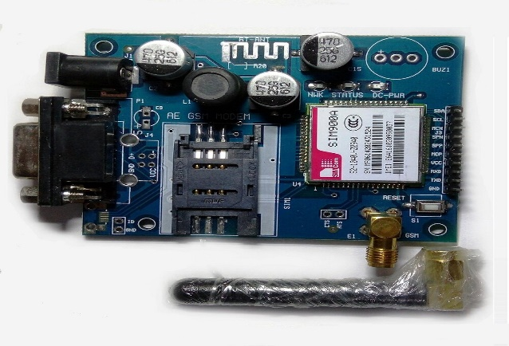
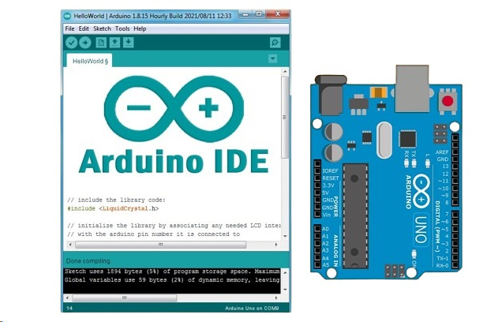

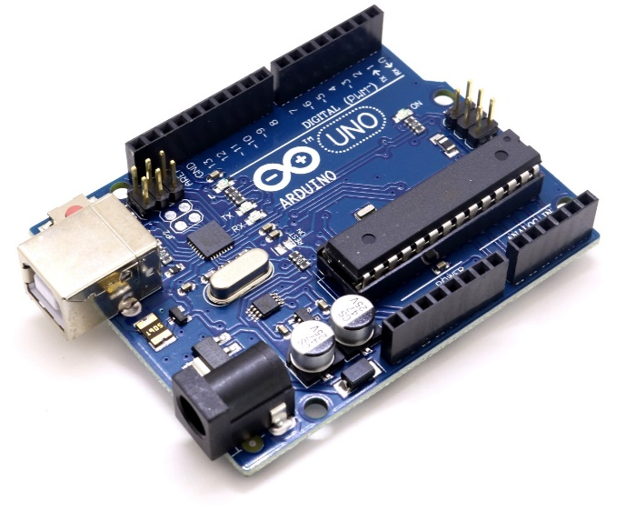
Material Specifications
MQ2 sensor
Flame sensor
GSM Module
Arduino UNO R3
Arduino IDE software
Servo Motor

Slide 7
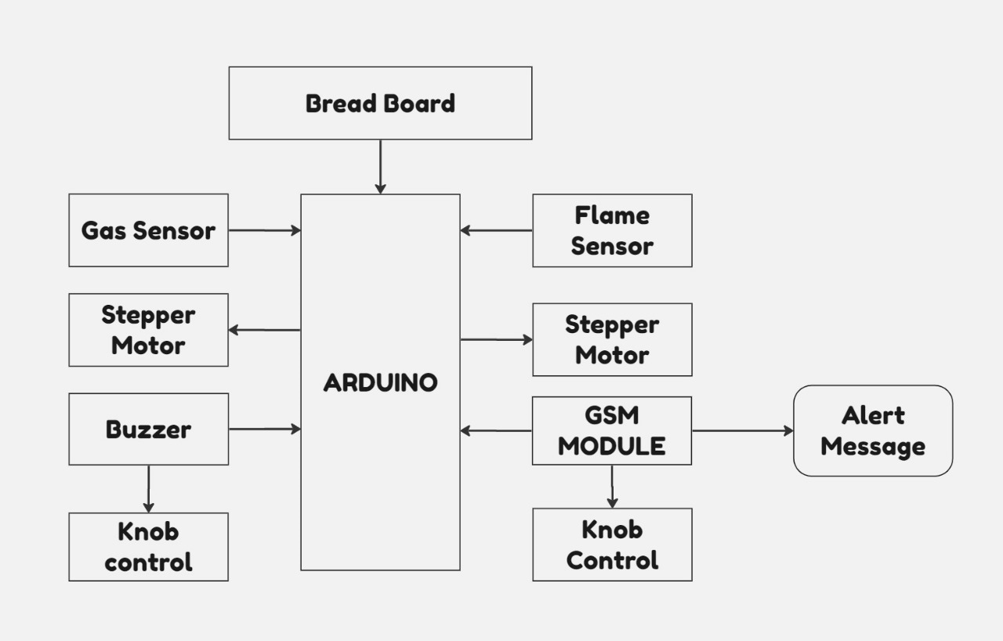
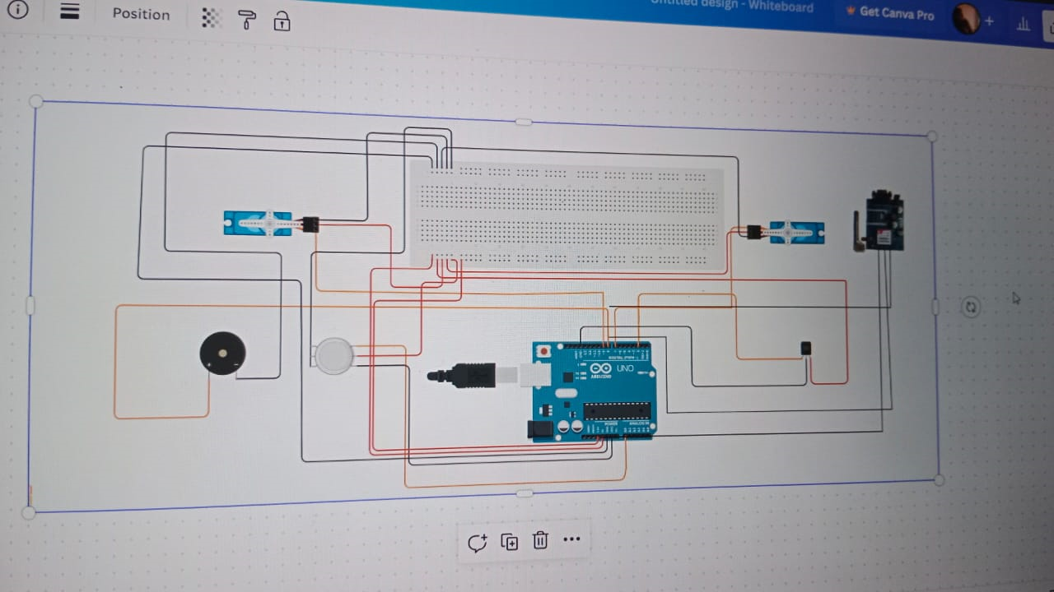
System Architecture
Servo
BLOCK DIAGRAM
CIRCUIT DIGRAM USING THINKER CAD

Slide 8
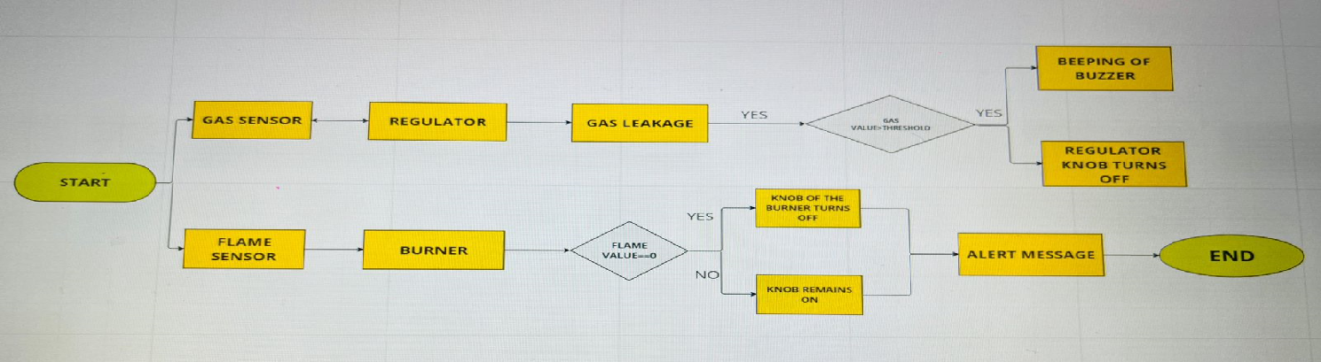
Experimental Work
The proposed smart gas system is designed to automatically respond when gas is detected. It comprises an MQ2 gas sensor, a flame sensor, a GSM module, and a servo motor connected to an Arduino UNO control system.
One important part is the Flame Sensor. It checks for flames and how strong they are. If it doesn't detect any flame (fire value == 0), it turns off the burner knob. But if it detects a flame (fire value != 0), the knob stays on.

Slide 9
The MQ2 gas sensor looks for gas leaks inside the regulator and measures how much gas there is in parts per million (PPM). If it finds gas, it checks how much is the concentration and if it's more than the limit (400 PPM), it automatically turns off the regulator knob.
Also, if the knob stays on for more than 20 minutes, the system tells the user with a message: "Reminder: Gas is ON for 20 minutes".
We can see how everything fits together in block diagrams and how to set it up.The sensor signals go to the Arduino UNO R3, and then to the GSM module.
It's important to put the gas sensor in the right spot, away from things like exhaust fans or chemicals that might give false readings.
And it's a good idea to set the right levels for gas concentration and sensitivity, so it doesn't give false alarms.

Slide 10
Results And Discussion
Presence of flame
Absence of flame
No Leakage of LPG
Leakage of LPG
Notification at 6:40
Notification at 6:45

Slide 11
Conclusion
In this documentation, we focus on designing a prototype for an IoT-based Smart detection system for gas leakage.
This gas emanation system has a broad scope of applications, including household safety and various industries.
The initiative undertaken by us that is used for gas seepage detection is a significant contribution to proactive safety measures, providing valuable insights into the system's performance and its potential impact on preventing gas-related incidents.
The system's beneficial effect on safety, along with the recommended improvements, positions a valuable asset for diverse environments.
We are committed to continuously evolving this technology to make substantial contributions to the prevention of gas-related incidents and the protection of lives and property.

Slide 12
References
[1] S. Lakshmi Lavanya, Gas Leakage Detector Using Arduino, IRJET Vol.10, pp.350-353, (2023).
[2] Juhi Choudhary, Detection of Gas Leakage and Automatic Alert System using Arduino, SSRN Electronic Journal, pp.263-264, (2019).
[3] Prof Babasaheb Jadhav, Sakshi Lobote, Gas Detection System: An innovative solution to domestic leaks and accidents using active window opening system, YMER-ISSN22(12), pp. 137-141, (2023).
[4] Neha Chourasia, Sensor-Based Gas Leakage Detector System, IJCRT10(6), pp. 679-685, (2022).
[5]Gazi Zahirul Islam, IoT-Based Automatic Gas Leakage Detection and Fire Protection System, Ijim16(21), pp.49-79, (2022).
[6] Dr. Chetana Tukkoji, LPG Gas Leakage Detection Using IoT, IJEAST 4(12), pp.603-609, (2020).
[7] . K. Manichandana, Gas Leakage Detection and Smart Alerting, Global Journal of Engineering Science and Researches, pp.24-30, (2018) K. Padma Priya, Smart Gas Cylinder Using Embedded System, IJIREEICE 2(2), pp.958- 962, (2014).
[8]. Aakash Parashar, Chachal Rai, IoT-Based Smart Gas Leakage Detection and Alert System, International Conference on Advances in Science & Technology (ICAST2021), pp.1-4

Slide 13

THANK YOU
THANK YOU

